Slide 1

OS Presentation: Cloud-Native Architecture
Presented by-
Mann Dodeja
Prithvi Dhirwani
Payal Dara
Raj Kukreja
Notes:
1

Slide 2


Cloud-Native Architecture: The Future of Scalable, Resilient Applications
Explore Cloud-Native Architecture and its pivotal role in modern application development. Key pillars include scalability, fault tolerance, microservices, containerization, and automation. 83% of enterprises now use cloud-native technologies.
Notes:
2

Slide 3
Core Principles: Microservices and Containerization
Microservices
Containerization
Decompose monolithic applications into smaller, independent services for agility.
Package applications and dependencies into isolated containers (Docker, Kubernetes).
Netflix breaks down streaming services into components as an example.
Docker containers reduce infrastructure costs by 50%.
Notes:
3

Slide 4

Scalability and Fault Tolerance: Building Resilient Systems
Scalability
Fault Tolerance
Circuit Breakers
Horizontally scale microservices to handle increasing workloads.
Design systems to withstand failures with redundancy and self-healing mechanisms.
Implement circuit breakers to prevent cascading failures.
Kubernetes automates scaling based on traffic.
Uptime guarantees of 99.99% for critical services. Downtime averages $5,600 per minute.
Notes:
4

Slide 5
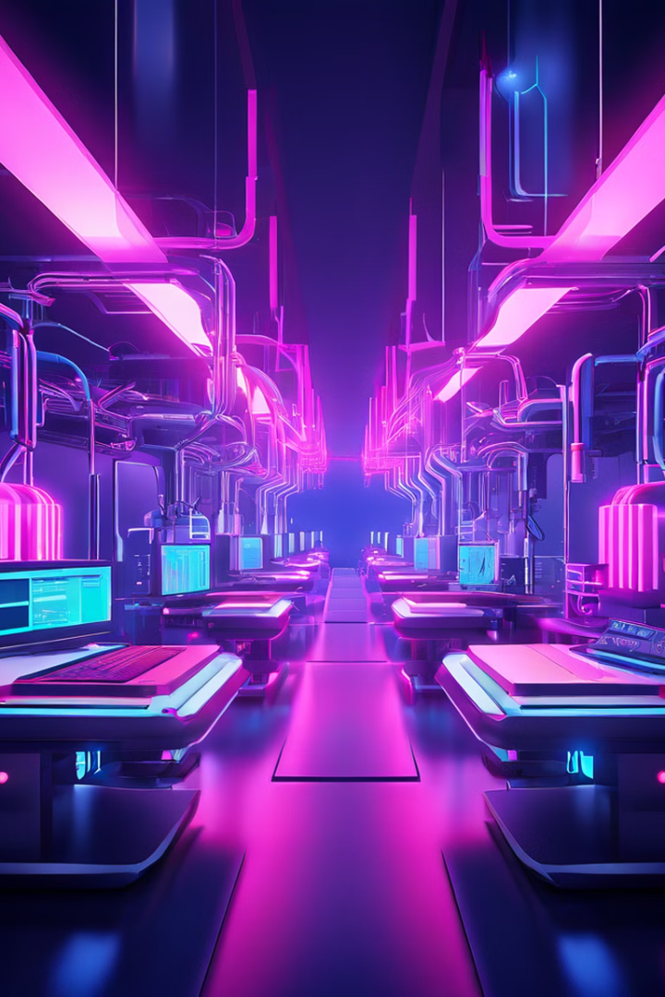


Automation and CI/CD: Accelerating Development Cycles
CI/CD
IaC
Automate the software delivery pipeline, enabling faster releases.
Manage infrastructure through code for repeatability and version control.
Companies with mature CI/CD pipelines deploy code 200x more frequently.
Notes:
5

Slide 6


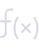

Serverless Computing: Focus on Code, Not Infrastructure
Serverless Functions
Event-Driven
Execute code without managing servers (AWS Lambda, Azure Functions).
Trigger functions based on events, like file uploads and database updates.
Benefits include reduced overhead, automatic scaling, and cost optimization. Serverless adoption grew 43% in 2023.
Notes:
6

Slide 7



Security in the Cloud-Native World
DevSecOps
Integrate security into every stage.
Container Security
Scan for vulnerabilities.
IAM
Secure user access.
Runtime protection detects real-time threats. Tools like Aqua Security secure containers.
Notes:
7

Slide 8




Observability: Gaining Insights into System Behavior
Monitoring
Collect metrics.
Tracing
Track requests.
Log Aggregation
Centralize logs.
Alerting notifies teams of critical issues. Observability reduces MTTR by 60%.
Notes:
8

Slide 9
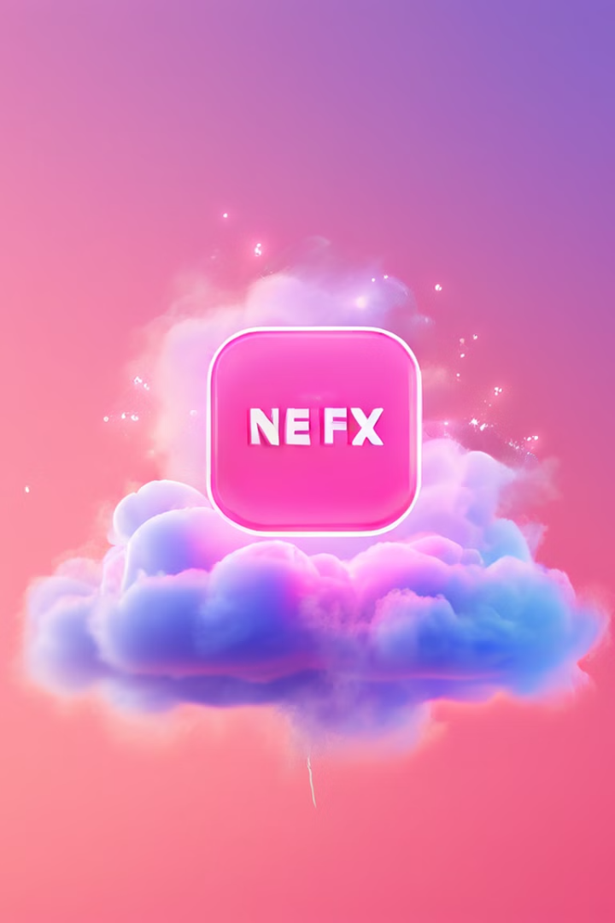
Real-World Examples of Cloud-Native Success
Netflix
Spotify
Leverages microservices, containerization, and automation for scalability.
Utilizes Kubernetes to manage containerized applications for music streaming.
Airbnb
Uses scalable infrastructure to handle peak travel seasons and user demand.
Notes:
9

Slide 10




Future Trends: Edge Computing and AI Integration
Edge Computing
Process data closer to the source to reduce latency and improve performance.
AI/ML Integration
Automate tasks, optimize performance, and enhance security.
Edge computing growth is expected to reach $43 Billion by 2027.
Notes:
10

Slide 11

Conclusion: Embracing the Cloud-Native Journey
Cloud-Native Architecture empowers organizations to build scalable and agile applications.
Adopt microservices, containerization, automation, and observability to accelerate innovation.
The future of application development is undoubtedly cloud-native.
Notes:
11

